Slide 1
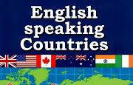
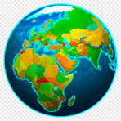
WELCOME TO THE
COUNTRY STUDY WORLD!
Speak English!

Slide 2
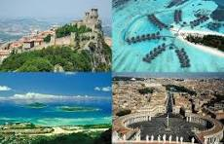
COUNTRIES
THE UNITED KINGDOM OF GREAT BRITAIN AND NORTHERN IRELAND
THE UNITED STATES OF AMERICA
AUSTRALIA
CANADA
jamaica + UKRAINE
NEW ZEALAND
SOUTH AFRICA

Slide 3

ACROSS CULTURES
CULTURE
LITERATURE
MUSIC
LANGUAGE

Slide 4
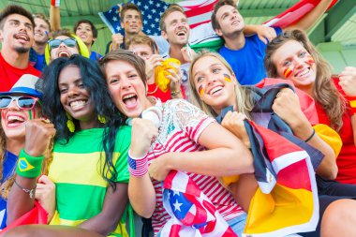
MEET PEOPLE AT THEIR HOMES!

Slide 5

EVERYDAY LIFE
PAST
PRESENT
FUTURE
Hooray!!!

Slide 6

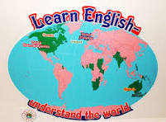
Travel
around
the world!!!

Slide 7
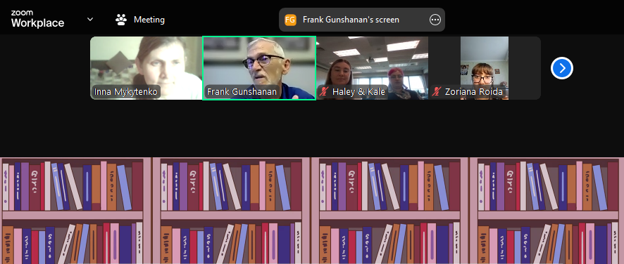
You will
know:
- general information on the physical geography of English-speaking countries;
- the political system of English-speaking countries;
- basic information on the history of the development of English-speaking countries;
- lifestyle, customs and traditions of English-speaking countries.

Slide 8
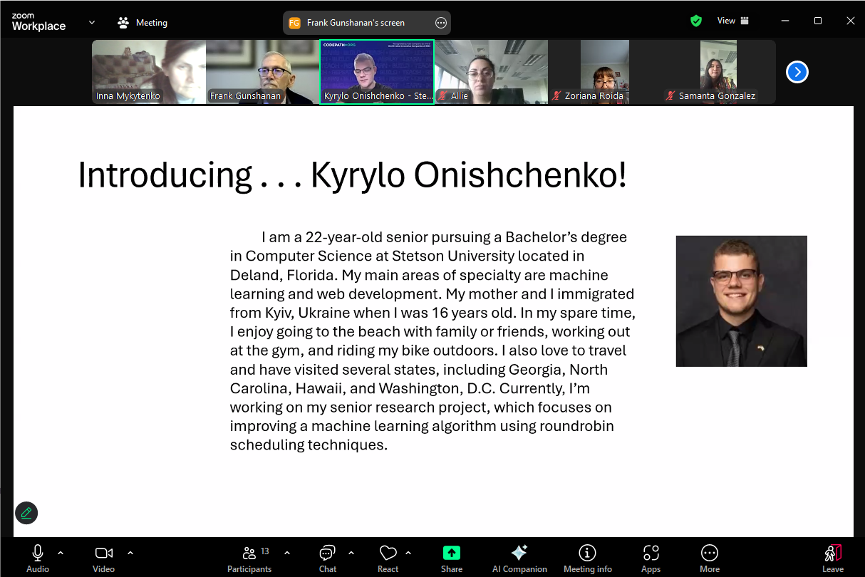
You will be able to
- prepare a story, report, presentation using ICT on the geographical location, political structure, natural conditions of English-speaking countries, their history, contribution to world culture;
- read and understand authentic texts of a country history nature;
- describe events in their historical development, highlighting their own point of view;
- find similar features and differences in the culture, customs and traditions, way of life of people of English-speaking countries and Ukraine;
- describe and interpret the realities of native and foreign cultures;
- analyze the phenomena of socio-political, economic and cultural life.

Slide 9
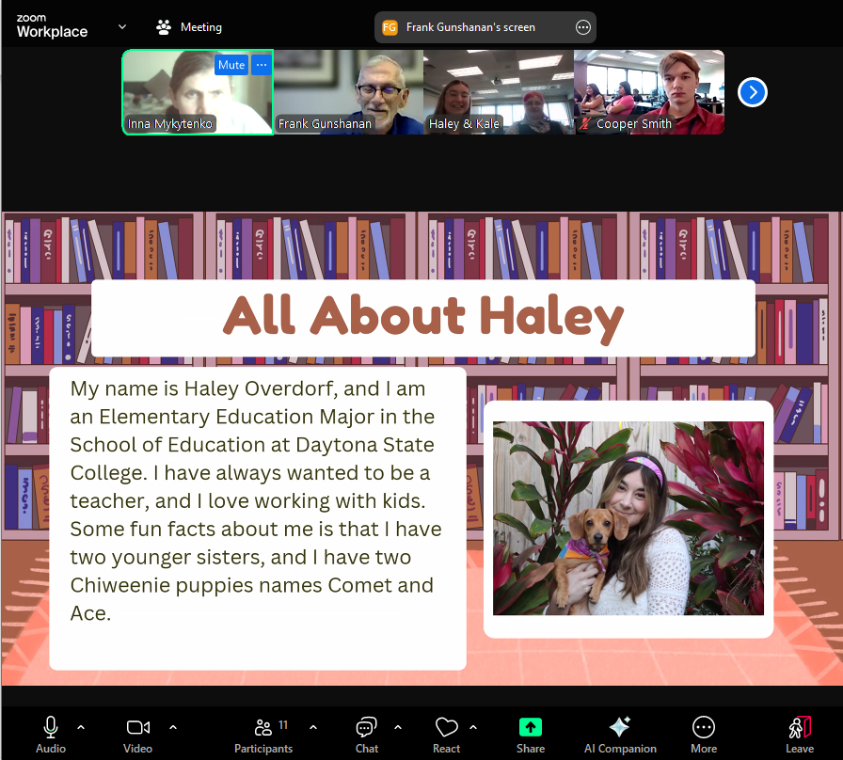
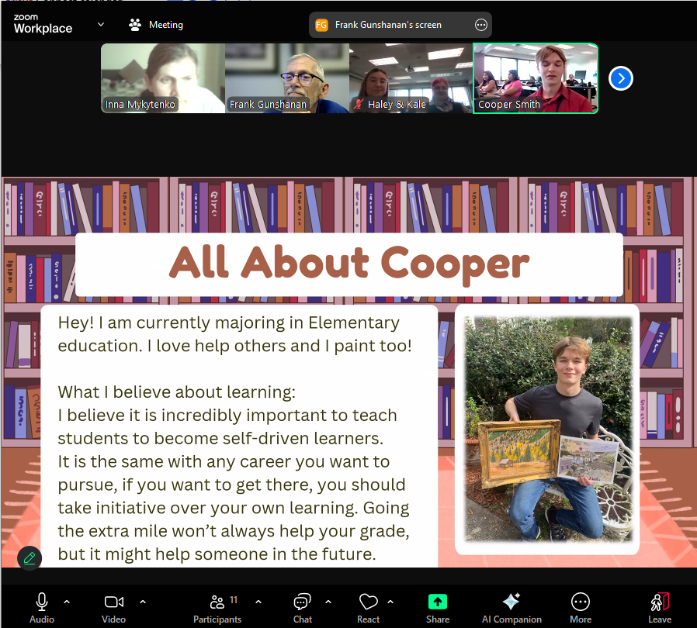

Slide 10
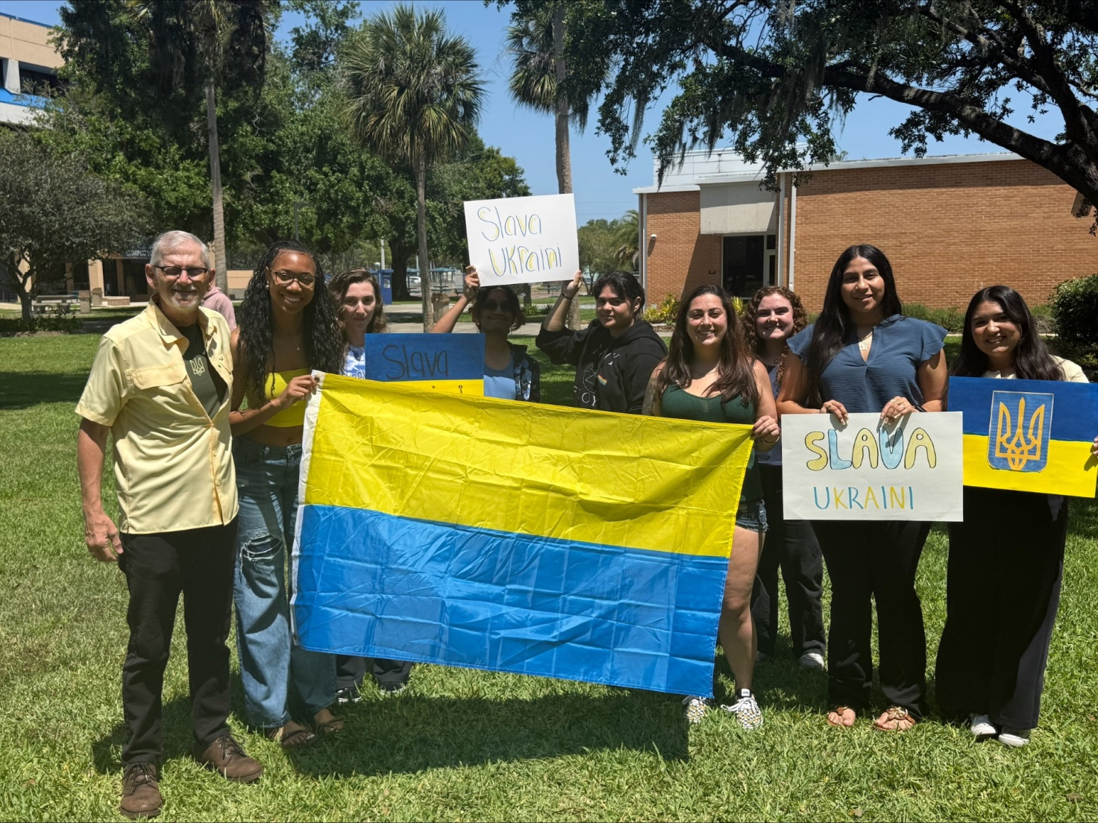
Peace and friendship with Peace Corps!

